Slide 1
Computer and Robot Vision I
Chapter 3
Binary Machine Vision:
Region Analysis
Presented by: 傅楸善 & 康家豪
r12922035@ntu.edu.tw
0967085045
指導教授: 傅楸善 博士

Slide 2
Outline
Region properties
- connected-components
- Signature analysis
Notes:
區域特性
連通元件
簽名分析

Slide 3
3.1 Introduction
region properties: measurement vector input to classifier
Notes:
圖像區域的屬性(性質)
測量向量輸入至分類器。

Slide 4
3.2 Region Properties
regions: produced by connected components labeling operator
region intensity histogram: gray level values for all pixels
mean gray level value: summary statistics of regions intensity
Notes:
區域亮度直方圖:所有像素的灰階值

Slide 5
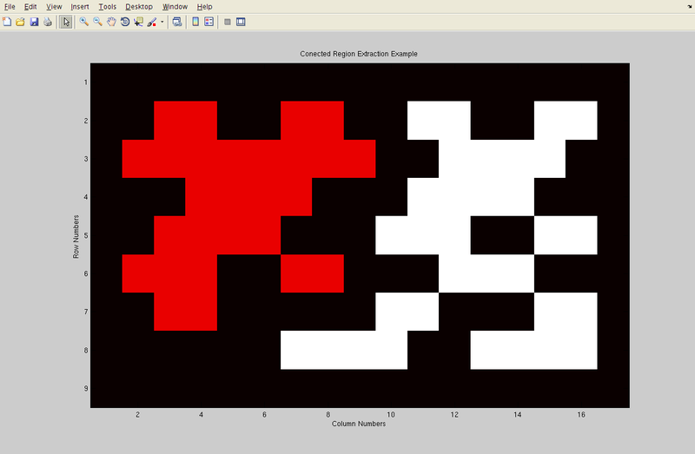
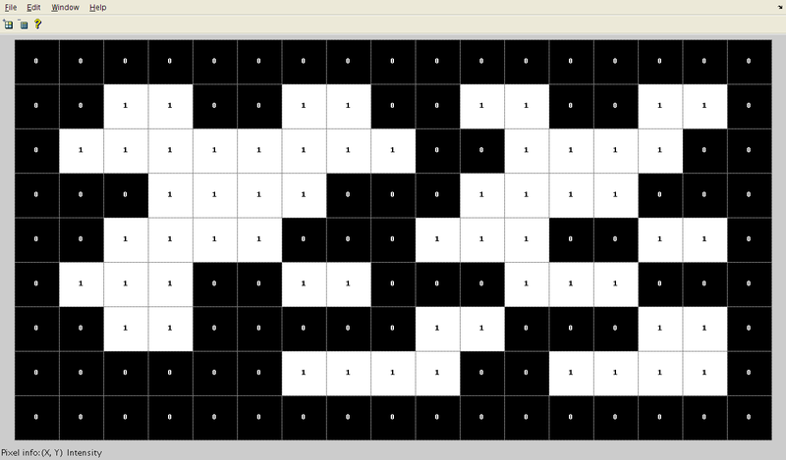
3.2 Region Properties (cont’)
https://zh.wikipedia.org/zh-tw/%E9%80%A3%E9%80%9A%E5%88%86%E9%87%8F%E6%A8%99%E8%A8%98
regions: produced by connected components labeling operator
Notes:
regions由連通元件標記運算子產生
運算子 ex: 在A+B-C中， +、- 是運算子; A、B、C是運算元

Slide 6



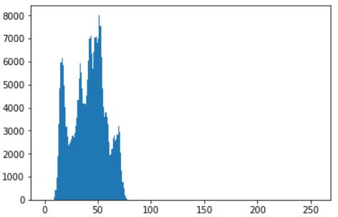
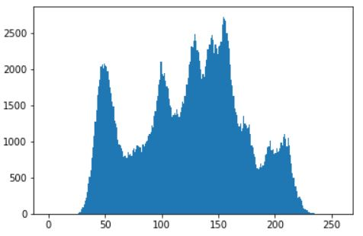
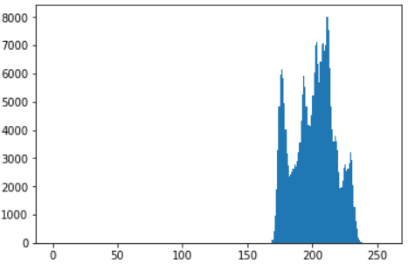
3.2 Region Properties (cont’)
region intensity histogram:
dark and low-contrast
original
bright and low-contrast

Slide 7
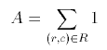
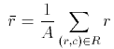
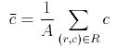
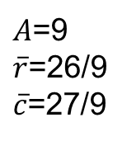
3.2 Region Properties (cont’)
bounding rectangle: smallest rectangle circumscribes the region
area:
centroid:
 | 1 | 2 | 3 | 4 | 5 | 6
1 | 0 | 0 | 0 | 0 | 1 | 0
2 | 0 | 1 | 1 | 1 | 1 | 0
3 | 0 | 0 | 1 | 1 | 0 | 0
4 | 1 | 1 | 1 | 0 | 0 | 0
5 | 0 | 0 | 0 | 0 | 0 | 0
$A$=9
$\overline{r}$=26/9
$\overline{c}$=27/9
Notes:
在周圍畫線；限制；為……下定義；為……劃界線
最小邊界矩形(Minimum bounding rectangle)
Centroid 質心

Slide 8
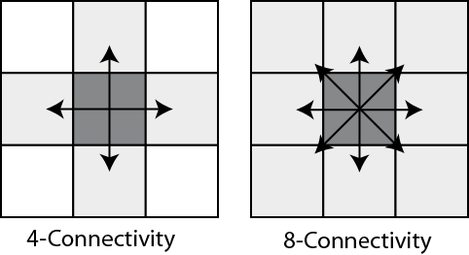
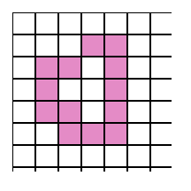
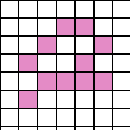
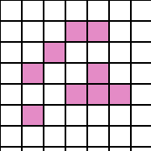

3.2 Region Properties (cont’)
https://www.imageprocessingplace.com/downloads_V3/root_downloads/tutorials/contour_tracing_Abeer_George_Ghuneim/connect.html
4-connectivity
8-connectivity
3 components
Notes:
https://www.imageprocessingplace.com/downloads_V3/root_downloads/tutorials/contour_tracing_Abeer_George_Ghuneim/connect.html

Slide 9
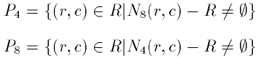
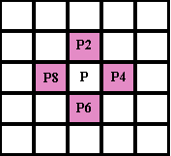
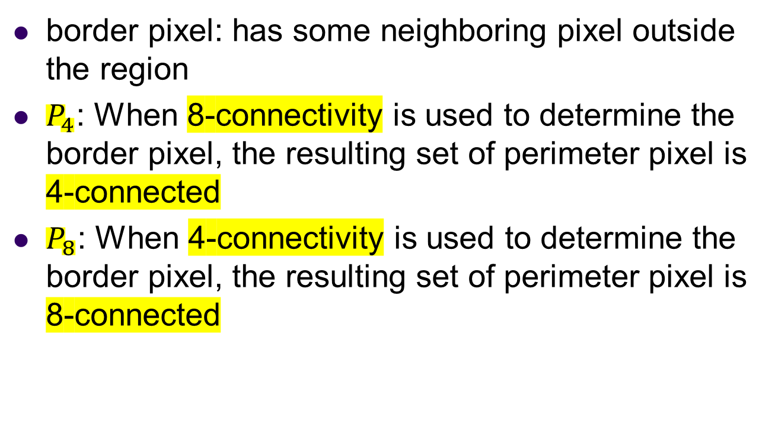
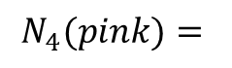
3.2 Region Properties (cont’)
border pixel: has some neighboring pixel outside the region
$P_{4}$: When 8-connectivity is used to determine the border pixel, the resulting set of perimeter pixel is 4-connected
$P_{8}$: When 4-connectivity is used to determine the border pixel, the resulting set of perimeter pixel is 8-connected
$$N_{4}(pink)=$$
Notes:
邊界像素: 像素的相鄰像素包含了非區塊內像素.我們稱為border pixel
P4:用8連通方式來決定邊界像素， 8個方位只要有一個是outside pixel就代表是border，最後border會以4-connectivity的方式相連
P8:用4連通方式來決定邊界像素， 4個方位只要有一個是outside pixel就代表是border，最後border會以8-connectivity的方式相連

Slide 10
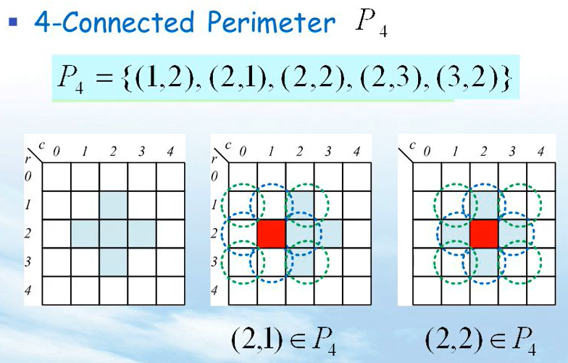
3.2 Region Properties (cont’)
https://slideplayer.com/slide/3411540/
Notes:
邊界像素: 像素的相鄰像素包含了非區塊內像素.我們稱為border pixel
P4:用8連通方式來決定邊界像素， 8個方位只要有一個是outside pixel就代表是border
P8:用4連通方式來決定邊界像素， 4個方位只要有一個是outside pixel就代表是border

Slide 11
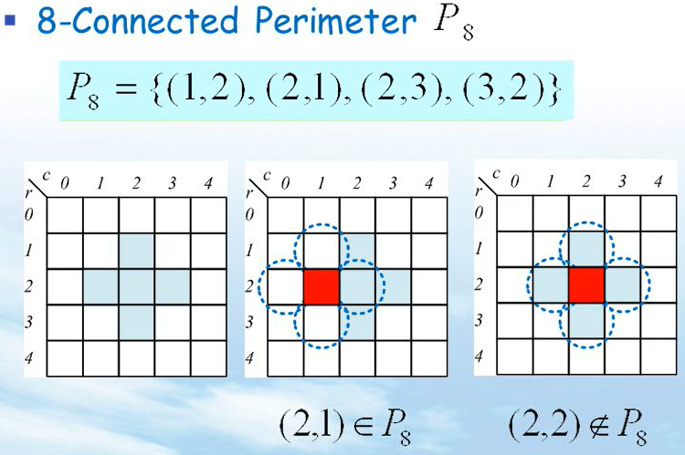
3.2 Region Properties (cont’)
https://slideplayer.com/slide/3411540/
Notes:
邊界像素: 像素的相鄰像素包含了非區塊內像素.我們稱為border pixel
P4:用8連通方式來決定邊界像素， 8個方位只要有一個是outside pixel就代表是border
P8:用4連通方式來決定邊界像素， 4個方位只要有一個是outside pixel就代表是border

Slide 12
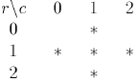
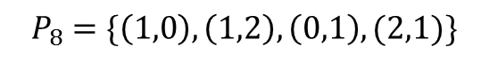
3.2 Region Properties (cont’)
Eg: center is in but not in for
$$P_{4}=\{\left(1,0\right),\left(1,1\right),\left(1,2\right),\left(0,1\right),\left(2,1\right)\}$$
$${ P}_{8} =\{\left(1,0\right),\left(1,2\right),\left(0,1\right),(2,1)\}$$

Slide 13
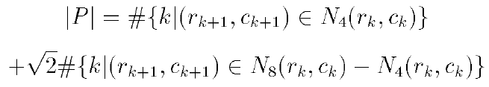
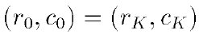
3.2 Region Properties (cont’)
length of perimeter
Pixel in P must be ordered in sequence.
Each pair of successive pixels being neighbors.
where k+1 is computed modulo K i.e.
Start pixel and end pixel are the same.
Notes:
set

Slide 14
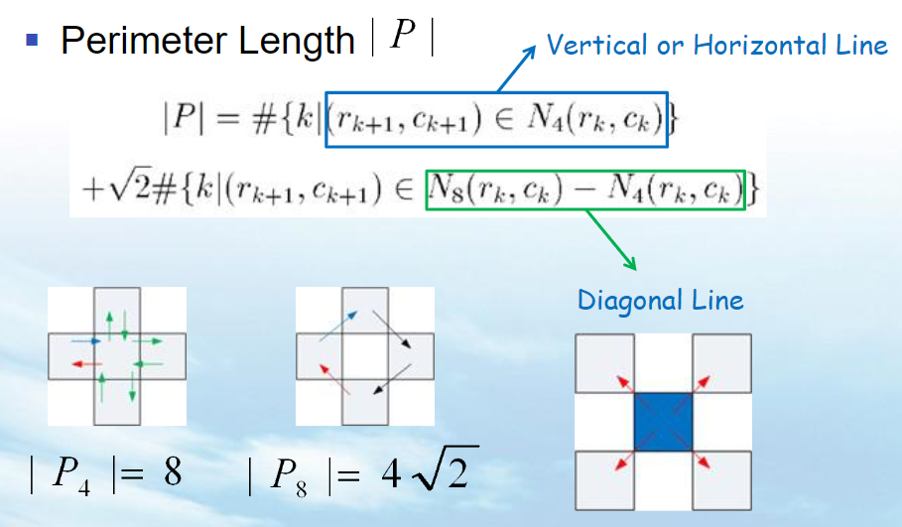
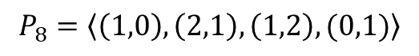
3.2 Region Properties (cont’)
# = number of
$$P_{4}=\left\langle \left(1,0\right),\left(1,1\right),\left(2,1\right),\left(1,1\right),\left(1,2\right),\left(1,1\right),\left(0,1\right),(1,1)\right\rangle$$
$$P_{8}=\left\langle \left(1,0\right),\left(2,1\right),\left(1,2\right),(0,1)\right\rangle$$

Slide 15
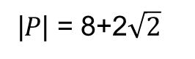
3.2 Region Properties (cont’)
e.g.
 | 1 | 2 | 3 | 4 | 5 | 6
1 | 0 | 0 | 0 | 0 | 0 | 0
2 | 0 | 1 | 1 | 1 | 1 | 0
3 | 1 | 1 | 1 | 1 | 0 | 0
4 | 1 | 1 | 1 | 1 | 0 | 0
5 | 0 | 0 | 0 | 0 | 0 | 0
|$P$| = 8+2$\sqrt{2}$

Slide 16
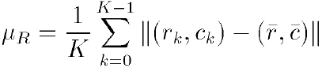
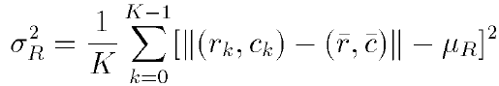
3.2 Region Properties (cont’)
mean distance R from the centroid to the shape boundary
standard deviation R of distances from centroid to boundary

Slide 17
3.2 Region Properties (cont’)
$$P_{4}=\left\langle \left(1,0\right),\left(1,1\right),\left(2,1\right),\left(1,1\right),\left(1,2\right),\left(1,1\right),\left(0,1\right),(1,1)\right\rangle$$

Slide 18
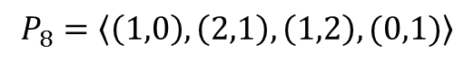
3.2 Region Properties (cont’)
$$P_{8}=\left\langle \left(1,0\right),\left(2,1\right),\left(1,2\right),(0,1)\right\rangle$$

Slide 19
3.2 Region Properties (cont’)
$$P_{4}=\left\langle \left(1,0\right),\left(1,1\right),\left(2,1\right),\left(1,1\right),\left(1,2\right),\left(1,1\right),\left(0,1\right),(1,1)\right\rangle$$

Slide 20
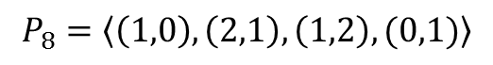
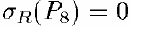
3.2 Region Properties (cont’)
$$P_{8}=\left\langle \left(1,0\right),\left(2,1\right),\left(1,2\right),(0,1)\right\rangle$$

Slide 21

3.2 Region Properties (cont’)
Haralick shows that has properties:
1. digital shape circular, increases monotonically
2. similar for similar digital/continuous shapes
3. orientation (rotation) and area (scale) independent
Notes:
圖形越接近圓形->standard deviation R 接近於0->增加
當兩張圖的形狀非常像時，數值會接近
方向與面積是獨立的

Slide 22
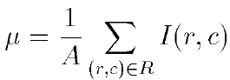
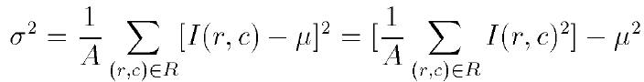
3.2 Region Properties (cont’)
Average gray level (intensity)
Gray level (intensity) variance
right hand equation lets us compute variance with only one pass

Slide 23
Joke Time

Slide 24
3.2 Region Properties (cont’)
microtexture properties: function of co-occurrence matrix
S: set of pixels in designated spatial relationship e.g. 4-neighbors co-occurrence matrix P
Notes:
這邊我們要介紹另一個特性，微紋理特性(微觀紋理屬性)，首先要介紹一個co-occurrence matrix共生矩陣 (兩個pixel之間的關係)
S：指定空間關係中的像素集，例如 4鄰域共現矩陣 P

Slide 25
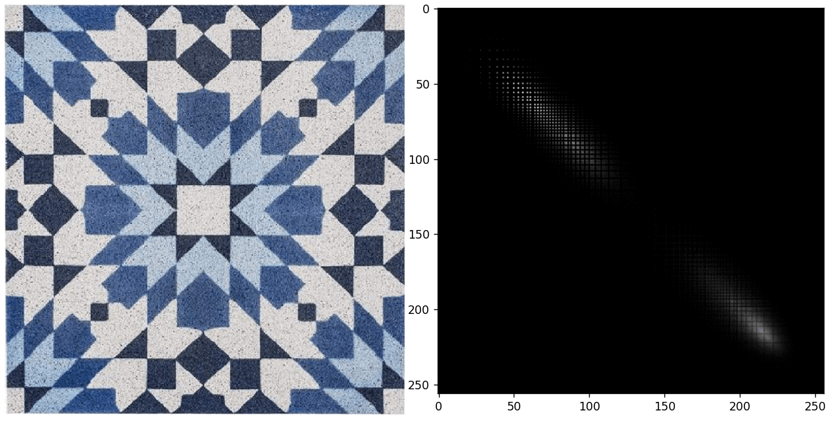
3.2 Region Properties (cont’)
Notes:
http://zhaoxuhui.top/blog/2022/03/15/gray-level-co-occurence-matrix.html
灰度共生矩陣
在規律的texture中，某些pixel pair出現的次數會特別多

Slide 26
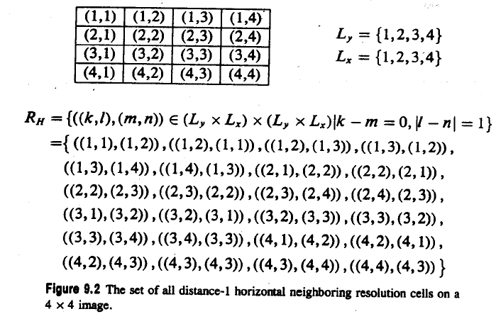
3.2 Region Properties (cont’)
region
Notes:
Pixel的位置矩陣
K-m=0 -> 同一個row
L-n = 1 -> 只能在隔壁
兩個像素點距離為1 角度為0
水平方向之像素pair的集合

Slide 27
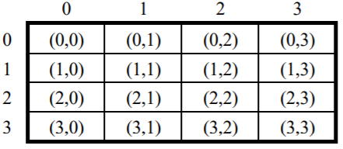
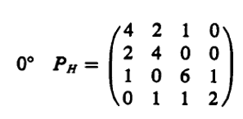
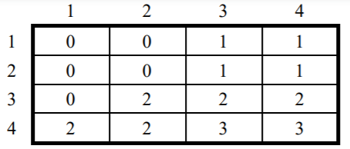
3.2 Region Properties (cont’)
0
P(0,0) = {
[(1,1),(1,2)],
[(1,2),(1,1)],
[(2,1),(2,2)],
[(2,2),(2,1)], } = 4

Slide 28
3.2 Region Properties (cont’)
0
P(0,0)={
[(1,2),(1,3)],
[(2,2),(2,3)]} = 2
Notes:
上圖共生矩陣
下圖灰階值

Slide 29
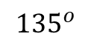
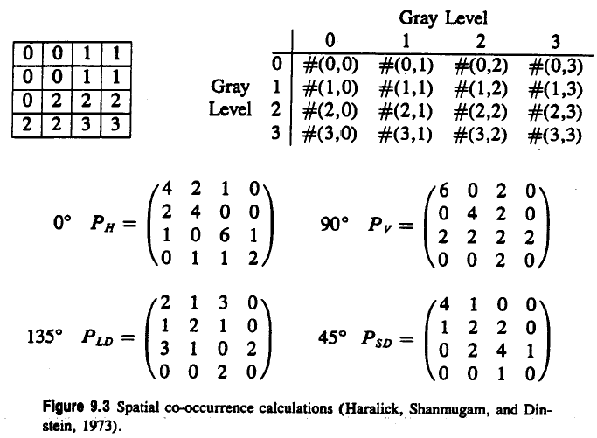
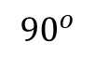
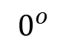
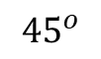
3.2 Region Properties (cont’)
Region(gray value intensity)
Co-occurrence matrix
0
Notes:
左邊為一個region的灰階值, 我們考慮投影角度為0 距離為1的的時co-occurance(灰階共現矩陣如右圖), index 為0

Slide 30
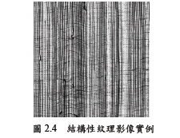
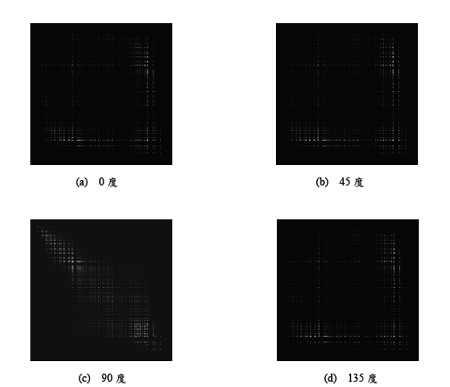
Structure texture
Notes:
Reference
紋理分析於瑕疵檢測的應用
The Application of Texture Analysis on Defect Detection

Slide 31
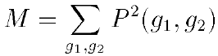
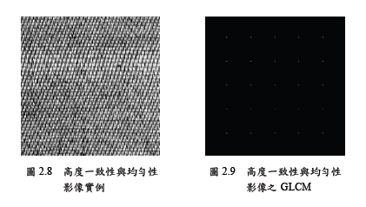
3.2 Region Properties (cont’)
texture second moment (Haralick, Shanmugam, and Dinstein, 1973)
High consistency and uniformity
Notes:
Reference
紋理分析於瑕疵檢測的應用
The Application of Texture Analysis on Defect Detection
P.17
Pair的關係比較聚集規律

Slide 32
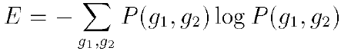
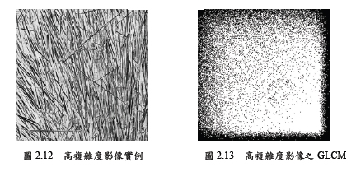
3.2 Region Properties (cont’)
texture entropy
High entropy
Notes:
Reference
紋理分析於瑕疵檢測的應用
The Application of Texture Analysis on Defect Detection
P.19
越大越混亂

Slide 33
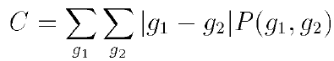

3.2 Region Properties (cont’)
texture contrast
High contrast
Notes:
Reference
紋理分析於瑕疵檢測的應用
The Application of Texture Analysis on Defect Detection
P.16
越大對比度越大

Slide 34


3.2 Region Properties (cont’)
texture homogeneity
where k is some small constant
High homogeneity
Notes:
Pixel value 相近

Slide 35


3.2 Region Properties (cont’)
texture correlation
where
Notes:
相關性

Slide 36
Joke Time

Slide 37
3.2.1 Extremal Points
Bounding rectangle has eight distinct extremal pixels: topmost right, rightmost top, rightmost bottom, bottommost right, bottommost left, leftmost bottom, leftmost top, topmost left
Notes:
邊界矩形極點

Slide 38

3.2.1 Extremal Points (cont’)

Slide 39

3.2.1 Extremal Points (cont’)
different extremal points may be coincident

Slide 40

3.2.1 Extremal Points (cont’)
association of the name of the eight extremal points with their coordinates

Slide 41

3.2.1 Extremal Points (cont’)
association of the name of an external coordinate with its definition

Slide 42


3.2.1 Extremal Points (cont’)
directly define the coordinates of the extremal points:
left
top

Slide 43

3.2.1 Extremal Points (cont’)
extremal points occur in opposite pairs:
topmost left bottommost right,
topmost right bottommost left,
rightmost top leftmost bottom,
rightmost bottom leftmost top
each opposite extremal point pair: defines an axis
axis properties: length, orientation
Notes:
opposite

Slide 44
3.2.1 Extremal Points (cont’)

Slide 45
3.2.1 Extremal Points (cont’)

Slide 46
3.2.1 Extremal Points (cont’)

Slide 47
3.2.1 Extremal Points (cont’)

Slide 48

3.2.1 Extremal Points (cont’)
orientation taken counterclockwise w.r.t. column (horizontal) axis

Slide 49






3.2.1 Extremal Points (cont’)
$$\tan{x}= \frac{a}{b}$$
orientation convention for the axes
axes paired: with and with
Notes:
與一般的笛卡兒座標系不同，row的部分是越往下數字越大，所以計算時要成一個負號

Slide 50



3.2.1 Extremal Points (cont’)
distance calculation: add a small increment to the Euclidean distance
Euclidean distance

Slide 51



3.2.1 Extremal Points (cont’)
length going from left edge of left pixel to right edge of right pixel
pixel
pixel

Slide 52



3.2.1 Extremal Points (cont’)
distance between ith and jth extremal points
average value of = 1.12, largest error 0.294 = - 1.12

Slide 53



3.2.1 Extremal Points (cont’)
calculation of the axis length and orientation of a line-like shape.

Slide 54








3.2.1 Extremal Points (cont’)
Properties of Triangular Shapes
Side Length L
L = ($M_{k_{1}k_{2}}$+ $M_{k_{1}k_{3}}$)/2
Base Length B
B = $M_{k_{2}k_{3}}$
Altitude Height h
$h=\sqrt{L^{2}−{(B/2)}^{2}}$
$k_{1}$ $(r_{k1 }, c_{k1})$
$k_{1}$, $k_{2}$, $k_{3}$= argmax($M_{k_{1}k_{2}}$+ $M_{k_{1}k_{3}}$)
L
h
$$∅$$
$$k_{2}$$
$$(r_{k2 }, c_{k2})$$
$$k_{3} (r_{k3 }, c_{k3})$$
$$B$$
Notes:
當角度越接近90度代表圖形越接近等腰三角形
L = 平均腰長 (近似斜邊)
B = 底長
H = 垂直三角形底長

Slide 55





calculations for length of sides base and altitude for a triangle

Slide 56
Joke Time

Slide 57



3.2.1 Extremal Points (cont’)
geometry of the tilted rectangle
Notes:
Tilted 傾斜的

Slide 58

definition
Two longest axes are diagonals of the rectangle and that these two longest axes are mate.
$M_{(1)}=$Length of longest axis
$M_{m(1)}=$Length of $M_{(1)}$’s mate
$Ø_{(1)}=O$rientation of longest axis
$Ø_{m(1)}=O$rientation of $Ø_{(1)}$’s mate
When${ Ø}_{(1)}$ or $Ø_{m(1)}$ is negative, ${360}^{°}$must be added to make it positive.

Slide 59







calculation for the orientation of an example rectangle
Two longest axes are diagonals of the rectangle and that these two longest axes are mate.
($M_{(1)}=$Length of longest axis)
($M_{m(1)}=$Length of $M_{(1)}$’s mate)
($Ø_{(1)}=O$rientation of longest axis)
($Ø_{m(1)}=O$rientation of $Ø_{(1)}$’s mate)
-180 = $\frac{\left(−43.99+360\right)+(−150.26+360)}{2} −180={82.875}^{°}$
Notes:
Two longest axes are diagonals of the rectangle and that these two longest axes are mate.

Slide 60
Joke Time

Slide 61



3.2.2 Spatial Moments
Second-order row moment
Second-order mixed moment
Second-order column moment
Notes:
Moment:矩

Slide 62

3.2.3 Mixed Spatial Gray Level Moments
region properties: position, extent, shape, gray level properties
Second-order mixed gray level property with spatial moments properties
Notes:
Extent 長度 範圍

Slide 63

3.2.3 Mixed Spatial Gray Level Moments (cont’)
1 2 3 4 5 6 7 8 9 10 11 12 13 14
01 02 03 04 05 06 07 08 09 10 11 12 13
connected components labeling of the image in Fig 2.2

Slide 64

3.2.3 Mixed Spatial Gray Level Moments (cont’)
all the properties measured from each of the regions

Slide 65


3.2.3 Mixed Spatial Gray Level Moments (cont’)

Slide 66
3.3 Signature Properties
vertical projection
horizontal projection
diagonal projection from lower left to upper right
diagonal projection from upper left to lower right

Slide 67

3.3 Signature Properties
vertical projection
horizontal projection

Slide 68




3.3 Signature Properties
$P_{D}$ 1 1 1 2
 | 1 | 2 | 3 | 4 | 5
1 | 0 | 0 | 0 | 0 | 0
2 | 0 | 1 | 1 | 0 | 0
3 | 0 | 0 | 1 | 1 | 0
4 | 0 | 0 | 1 | 0 | 0
5 | 0 | 0 | 0 | 0 | 0
$$P_{H}$$
2
2
1
$P_{V}$ 1 3 1
${ P}_{E}$ 1 2 2

Slide 69
Joke Time

Slide 70

3.3 Signature Properties (cont’)
Projections: easily obtainable in pipeline hardware
compute properties from projections
area

Slide 71
3.3 Signature Properties (cont’)
rmin: top row of bounding rectangle
rmax; bottom row of bounding rectangle
cmin: leftmost column of bounding rectangle
cmax: rightmost column of bounding rectangle

Slide 72




3.3 Signature Properties (cont’)
row centroid
column centroid
diagonal centroid
another diagonal centroid

Slide 73
3.2.2 Spatial Moments(review)
Second-order row moment(矩)
Second-order mixed moment
Second-order column moment

Slide 74



3.3 Signature Properties (cont’)
second row moment from horizontal projection
second column moment from vertical projection
second diagonal moment from diagonal projection

Slide 75


3.3 Signature Properties (cont’)
second diagonal moment related to
second mixed moment can be obtained from projection
second diagonal moment related to

Slide 76


3.3 Signature Properties (cont’)
second mixed moment can be obtained from projection
mixed moment obtained directly from and

Slide 77
Joke Time

Slide 78

3.3.1 Signature Analysis to Determine the Center and Orientation of a Rectangle
signature analysis: important because of easy, fast implementation
surface mount device (SMD) placement: position and orientation of parts
Notes:
可用於表面貼裝器件 (SMD)的 放置：找出零件的位置和方向

Slide 79






3.3.1 Signature Analysis to Determine the Center and Orientation of a Rectangle (cont’)
determine center of rectangle by corner location
side lengths w, h orientation angle $θ$
clockwise
(x, y) = ($\frac{w}{2}, −\frac{h}{2}$)
$$\left({∆x \atop ∆y}\right)=\left({a1 \atop b1}\right)+ \left({x_{rot} \atop y_{rot}}\right)$$
$$=\left({a1 \atop b1}\right)+ \left({cosθ sinθ \atop −sinθ cosθ}\right)\left({\frac{w}{2} \atop −\frac{h}{2}}\right)$$

Slide 80


3.3.1 Signature Analysis to Determine the Center and Orientation of a Rectangle (cont’)
(x, y) = ($\frac{w}{2}, −\frac{h}{2}$)
h
(x, y) = ($\frac{w}{2}, −\frac{h}{2}$)
w

Slide 81



3.3.1 Signature Analysis to Determine the Center and Orientation of a Rectangle (cont’)
(x, y) = ($\frac{w}{2}, −\frac{h}{2}$)
clockwise
$$θ$$
($x_{rot}$, $y_{rot}$)
h
w

Slide 82




3.3.1 Signature Analysis to Determine the Center and Orientation of a Rectangle (cont’)
($a_{1}$, $b_{1}$)
$$\left({∆x \atop ∆y}\right)=\left({a1 \atop b1}\right)+ \left({x_{rot} \atop y_{rot}}\right)$$
$$=\left({a1 \atop b1}\right)+ \left({cosθ sinθ \atop −sinθ cosθ}\right)\left({\frac{w}{2} \atop −\frac{h}{2}}\right)$$
($x_{rot}$, $y_{rot}$)
($∆x$, $∆y$)
h
w

Slide 83
Joke Time

Slide 84

partition rectangle into six regions formed by two vertical lines
a known distance g apart and one horizontal line

Slide 85

partition rectangle into six regions formed by two vertical lines
a known distance g apart and one horizontal line

Slide 86


3.3.1 Signature Analysis to Determine the Center and Orientation of a Rectangle (cont’)
Calculate u
=>
=>

Slide 87


partition rectangle into six regions formed by two vertical lines
a known distance g apart and one horizontal line

Slide 88



3.3.1 Signature Analysis to Determine the Center and Orientation of a Rectangle (cont’)
Calculate v
=>
=>
$$w^{2}tanθ$$

Slide 89
3.3.1 Signature Analysis to Determine the Center and Orientation of a Rectangle (cont’)
Notes:
知道中心點後可以推出角度

Slide 90


|
Notes:
知道中心點後可以推出角度

Slide 91

3.3.1 Signature Analysis to Determine the Center and Orientation of a Rectangle (cont’)
Rotation angle:
$$E+F=h\frac{g}{cosθ}$$
$$cosθ=\frac{hg}{E+F}$$

Slide 92
Joke Time

Slide 93

3.3.2 Using Signature to Determine the Center of a Circle
partition the circle into four quadrants formed by two orthogonal lines which meet inside the circle
geometry for the circle, its center, and a chord

Slide 94





Area of Sector $= πr^{2}∗\frac{θ}{2π}=r^{2}∗\frac{θ}{2}$
3.3.2 Using Signature to Determine the Center of a Circle (cont’)
$$=dr\sqrt{1−{\left(\frac{d}{r}\right)}^{2}}$$
$$dr\sqrt{1−{\left(\frac{d}{r}\right)}^{2}}$$
http://cv2.csie.ntu.edu.tw/CV/_material/CV1_CH3_2019_v2.pdf

Slide 95


3.3.2 Using Signature to Determine the Center of a Circle (cont’)
$$=rcosθ$$
http://cv2.csie.ntu.edu.tw/CV/_material/CV1_CH3_2019_v2.pdf

Slide 96



3.3.2 Using Signature to Determine the Center of a Circle (cont’)
circle projected onto the four quadrants of the projection index image
$$\left(∆x, ∆y\right)=center of cicle$$
$$∆x$$

Slide 97




3.3.2 Using Signature to Determine the Center of a Circle (review)
$$r= \sqrt{\frac{A+B+C+D}{π}}$$
$$A+B=\frac{A+B+C+D}{2π}[2θ −sin2θ]$$

Slide 98


3.3.2 Using Signature to Determine the Center of a Circle (review)
$$A+B=\frac{A+B+C+D}{2π}[2θ −sin2θ]$$
$$r= \sqrt{\frac{A+B+C+D}{π}}$$

Slide 99

3.3.2 Using Signature to Determine the Center of a Circle (review)
$$A+B=\frac{A+B+C+D}{2π}[2θ −sin2θ]$$
$$r= \sqrt{\frac{A+B+C+D}{π}}$$

Slide 100
3.3.2 Using Signature to Determine the Center of a Circle (cont’)
each quadrant area from histogram of the masked projection
positive if A + B > C + D negative otherwise
positive if B + D > A + C negative otherwise

Slide 101
3.4 Summary
region properties from connected components or signature analysis

Slide 102
Joke Time

Slide 103



Histogram Equalization (Homework)
pixel transformation
- r, s: original, new intensity,
T: transformation
-T( r ) single-valued, monotonically increasing
- for
Notes:
直方圖均衡化 (Histogram equalization)

Slide 104



Slide 105




Histogram Equalization (Homework)
Cumulative Distribution Function
(CDF)
Notes:
Source Image -> Histogram
利用 Histogram 算出各個灰階值的 probability density function
將PDF 做累加求出 CDF
將CDF 的結果 4捨5入後做出對照表
透過查詢剛剛建立的對照表，決定Transition 完各個灰階值的機率

Slide 106




Histogram Equalization (Homework)
Origin Histogram
CDF of Origin Histogram
CDF
Equalized Histogram
CDF of Equalized Histogram
255 * CDF
CDF
Notes:
global histogram equalization的目的是要把CDF的形狀排成整齊的直角三角形，
所以會將每條CDF放到合適的位置，使得對邊(CDF的值)與鄰邊(CDF * max value)是一個固定的比例，
這樣排出來的CDF會近似成一個漂亮的直角三角形。
Source Image -> Histogram
利用 Histogram 算出各個灰階值的 probability density function
將PDF 做累加求出 CDF
將CDF 的結果 4捨5入後做出對照表
透過查詢剛剛建立的對照表，決定Transition 完各個灰階值的機率

Slide 107


Histogram Equalization

Slide 108
Histogram Equalization (Homework)
Project due Oct. 3, 2023:
Write a program to do histogram equalization

Slide 109
重點提示
p.7 area and centroid
p.15 perimeter length

Slide 110
End

